Slide 1

Machine Learning techniques for predicting energy and CO2 Emissions in Seattle City
University of Saint Joseph of Beirut
Presented by: Nour Abboud
Evaluated by: Dr.Eng Nicole Challita

Slide 2

Introduction
Data Preprocessing
Exploratory Data Analysis
Modeling
Conclusion
Plan

Slide 3
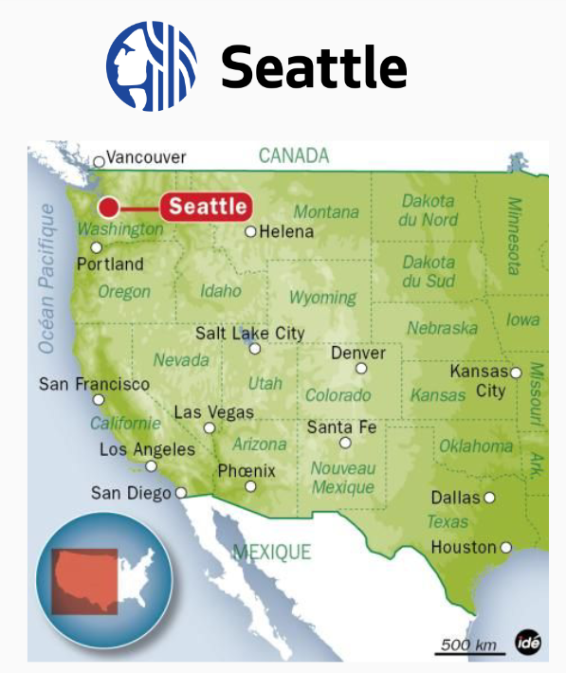
Introduction
Washington State Capital
Huge city in the state
Non-Residential buildings
City empty of greenhouse gas in 2050
Prediction of CO2 Emissions and Energy Consumption

Slide 4
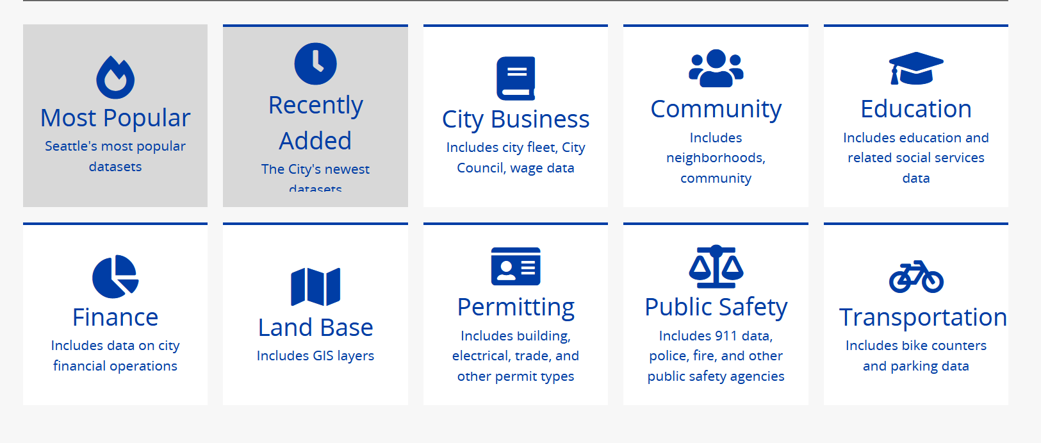
Data
Types of data
2015 ( 3340 obs / 47 Features)
2016 (3376 obs / 45 Features)
Categorical: neighborhood, property use type, building type
Numerical: surfaces ,energy consumption, CO2 emissions

Slide 5
Data Preprocessing
Data Cleaning
Comparison of the datasets ‘ columns
Standardization of variables: location, id, ghg
Conservation of non-residential buildings
Dealing with NaNs
Observations of Features
Dropping Duplicated indexes

Slide 6
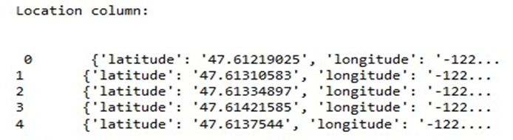
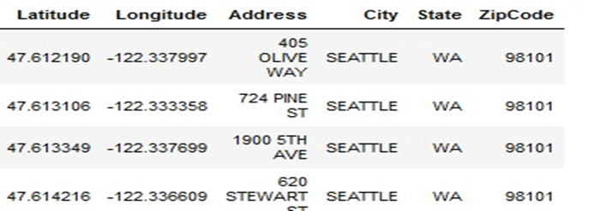
Data Cleaning
Before Standardization
After Standardization
Fix columns ‘names
Rename columns…

Slide 7
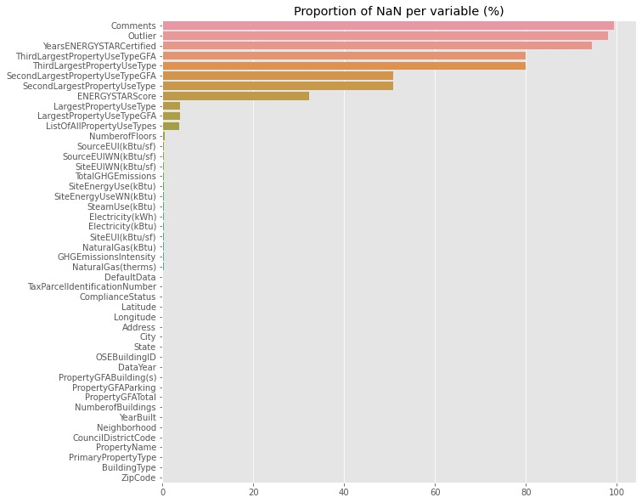
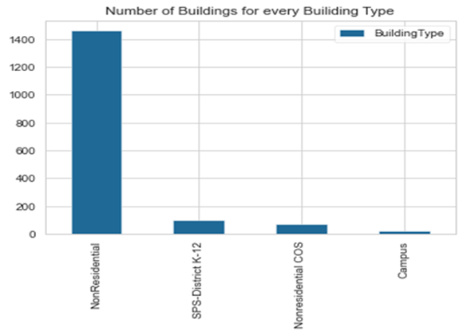
Data Cleaning
Dealing with NaNs
Conservation of non-residential buildings
Filling the NaNs
Dropping duplicated indexes

Slide 8


Data Preprocessing
Data Integration
Data Reduction
Dataset 2015 + Dataset 2015= New Dataset
Removing variables that do not interest us (ex suffixes WN)

Slide 9
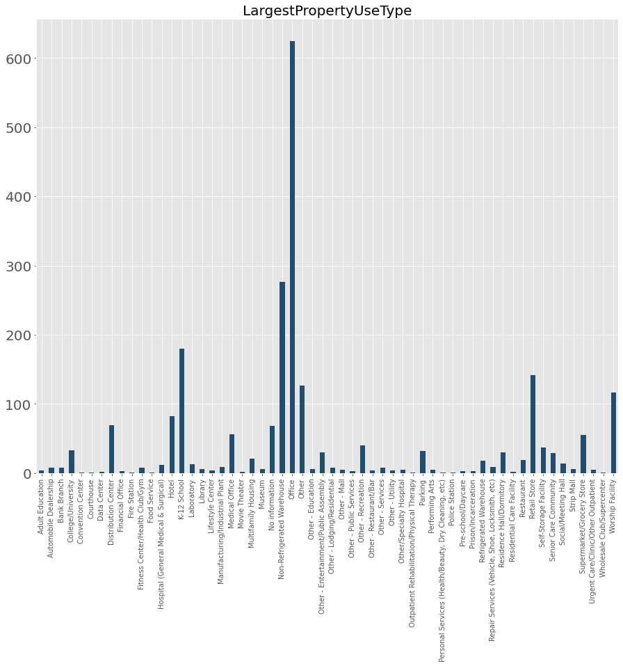
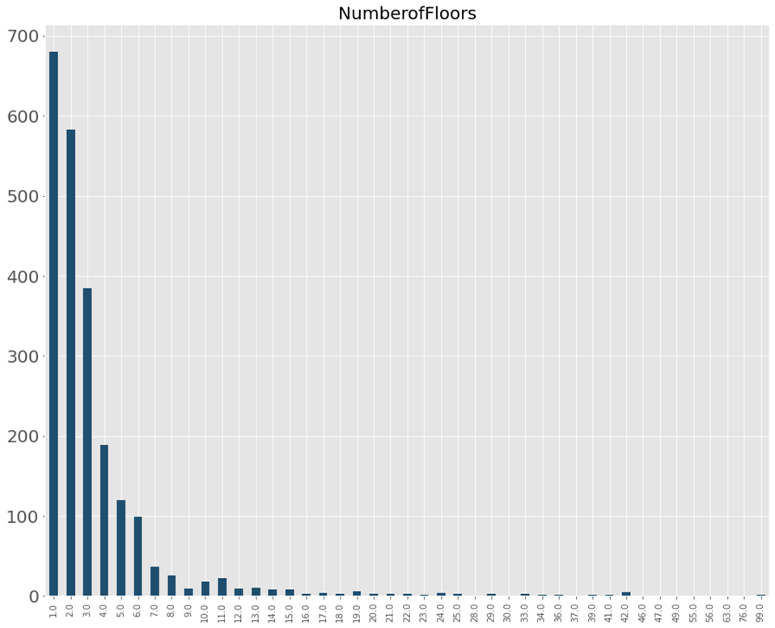
LargestPropertyUseType
Exploratory Data Analysis
Number Of Floors

Slide 10
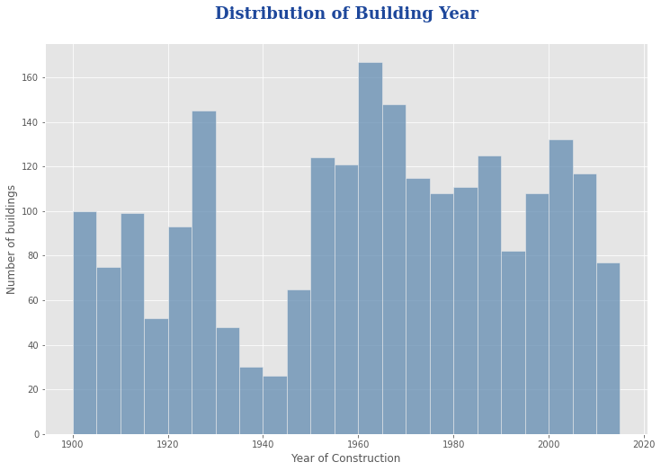
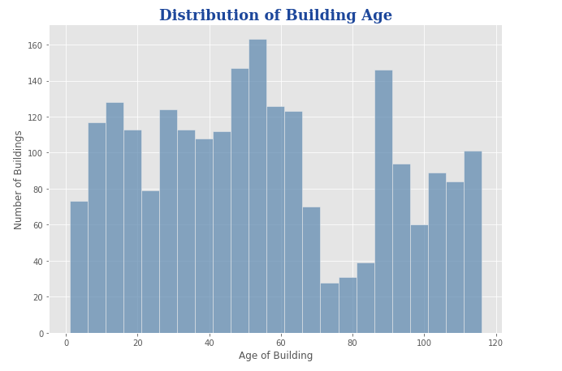
Building Year
Exploratory Data Analysis
Building Age

Slide 11
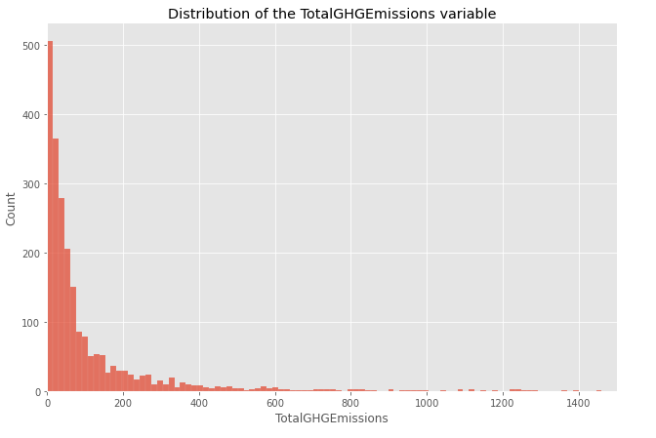
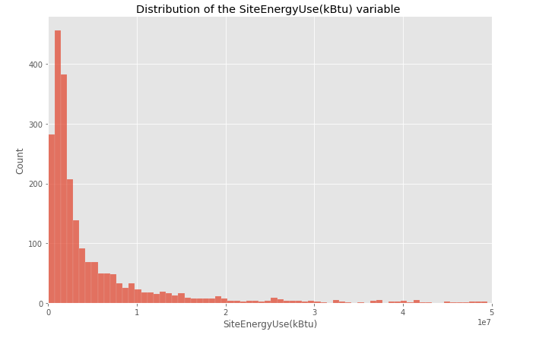
Total CO2 Emissions
Exploratory Data Analysis
Energy Consumption

Slide 12
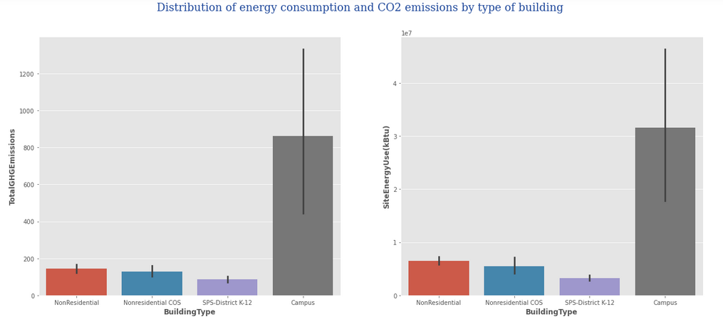
Exploratory Data Analysis

Slide 13
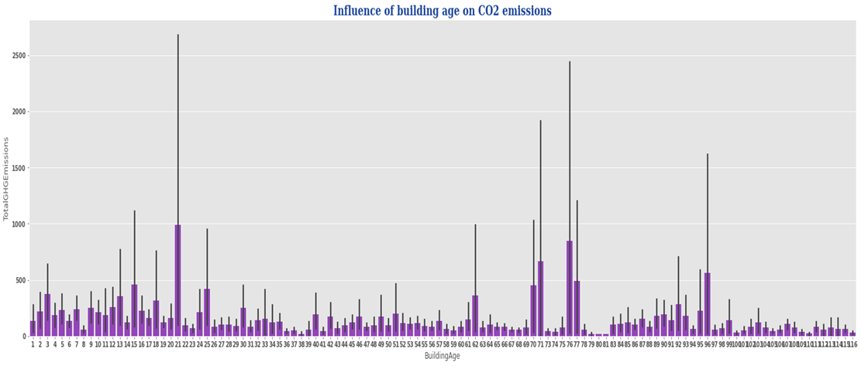
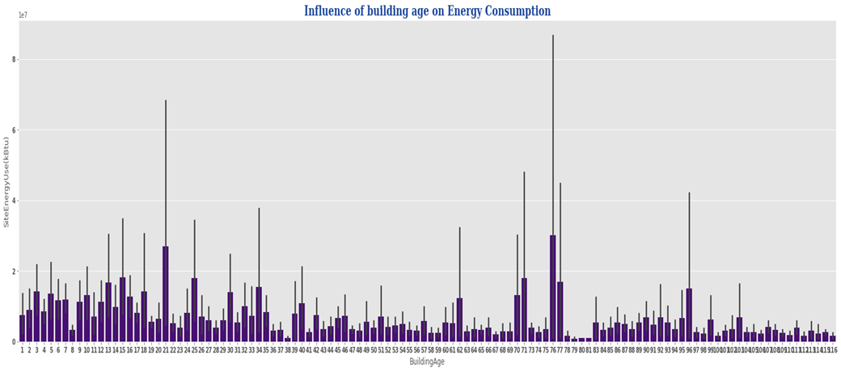
Exploratory Data Analysis

Slide 14
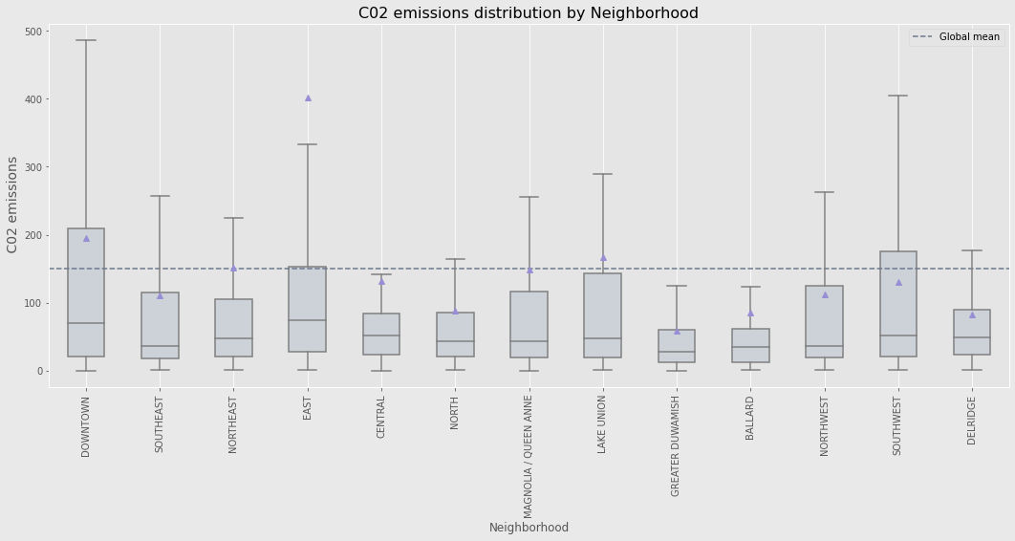
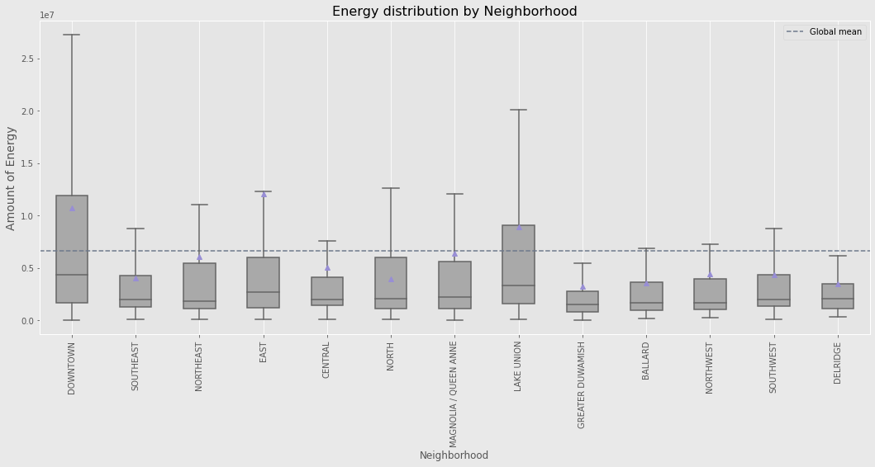
Exploratory Data Analysis

Slide 15
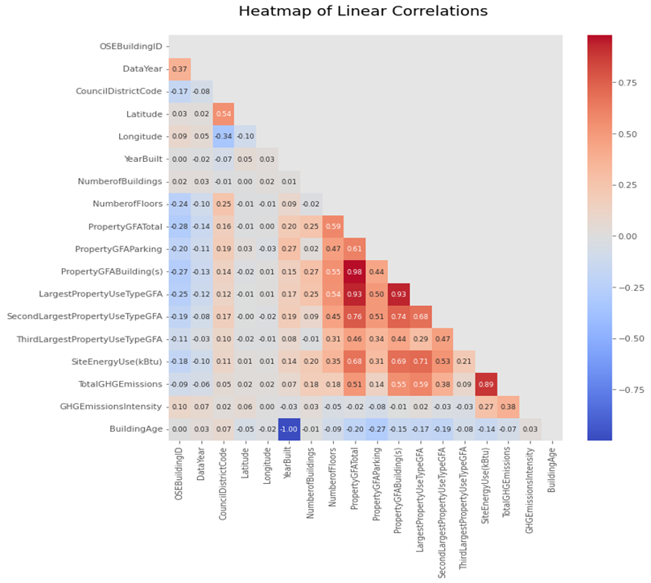
Exploratory Data Analysis
How to prevent collinearity problems?
Create new alternative variables:
GFABuildingRate, GFAParkingRate

Slide 16
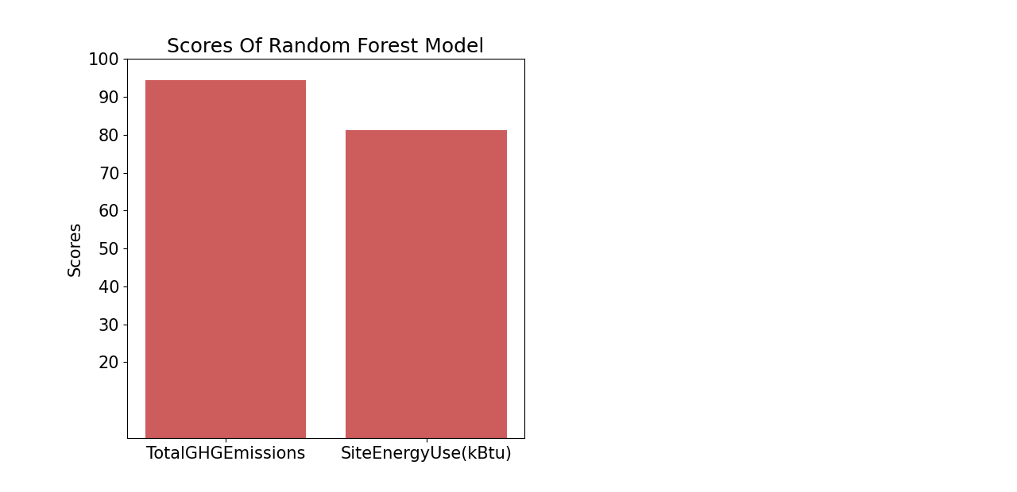
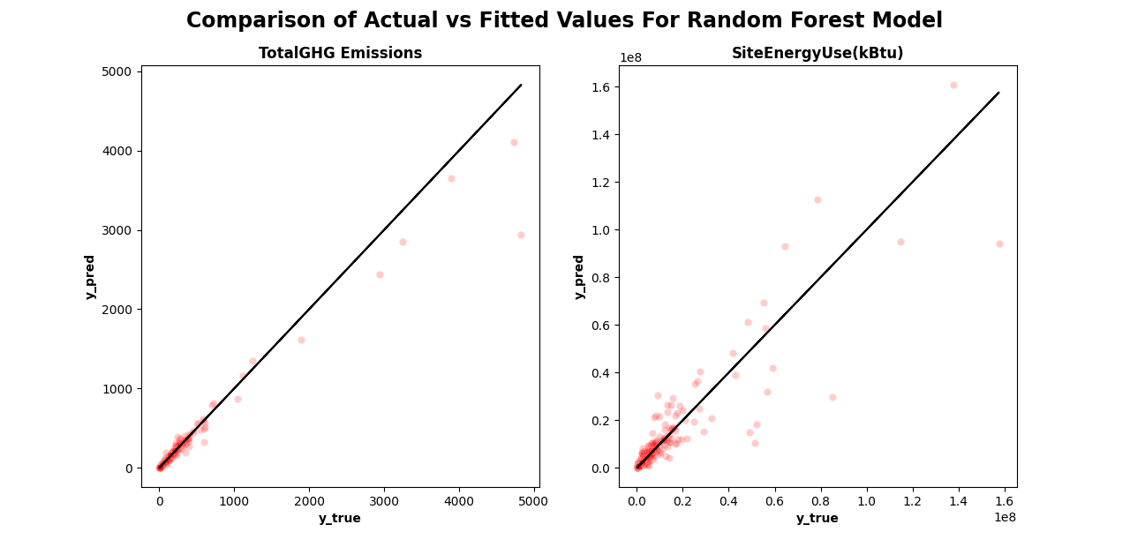
Modeling
Random Forest Model

Slide 17
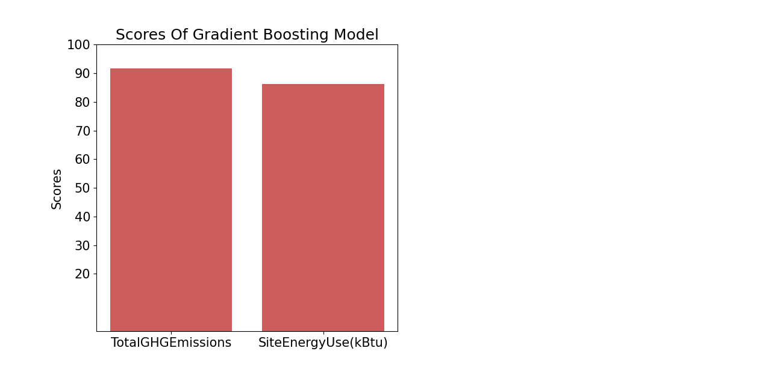
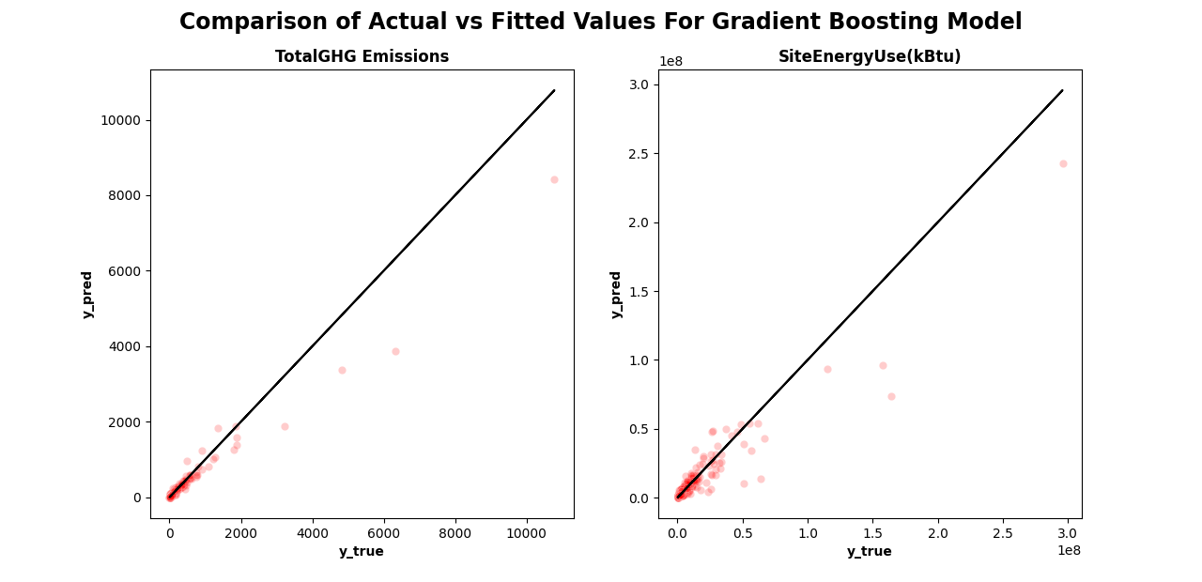
Modeling
Gradient Boosting Model

Slide 18
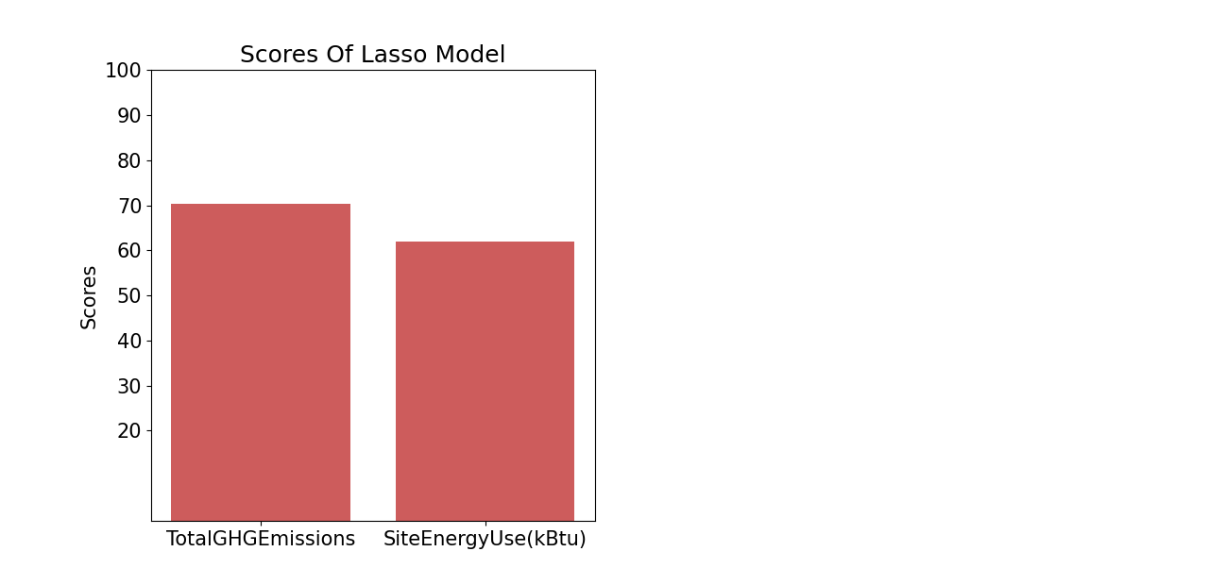
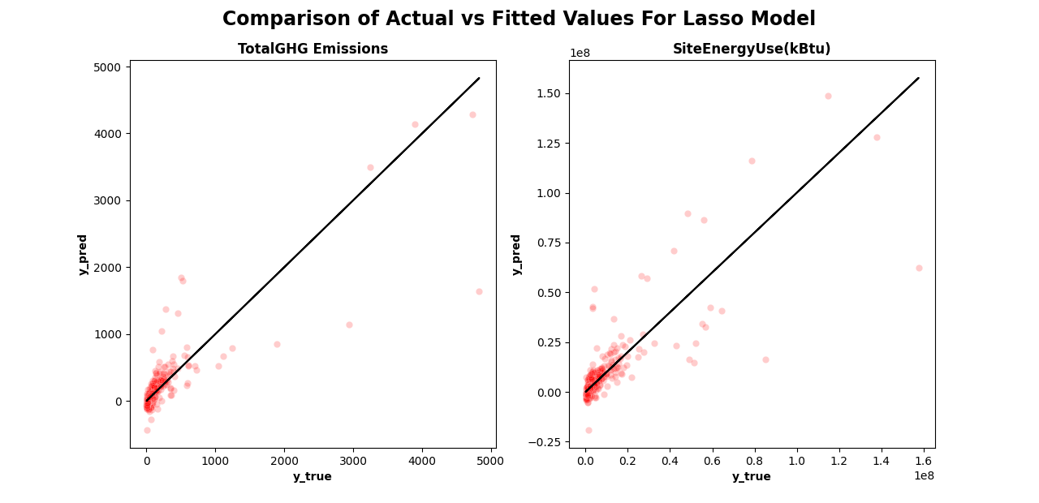
Modeling
Lasso Model

Slide 19
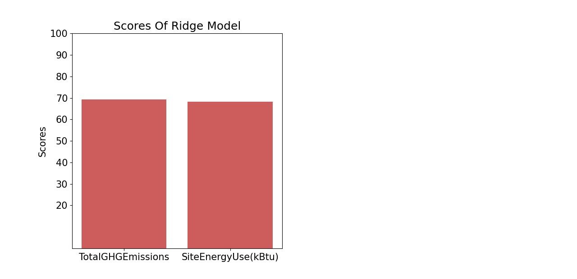
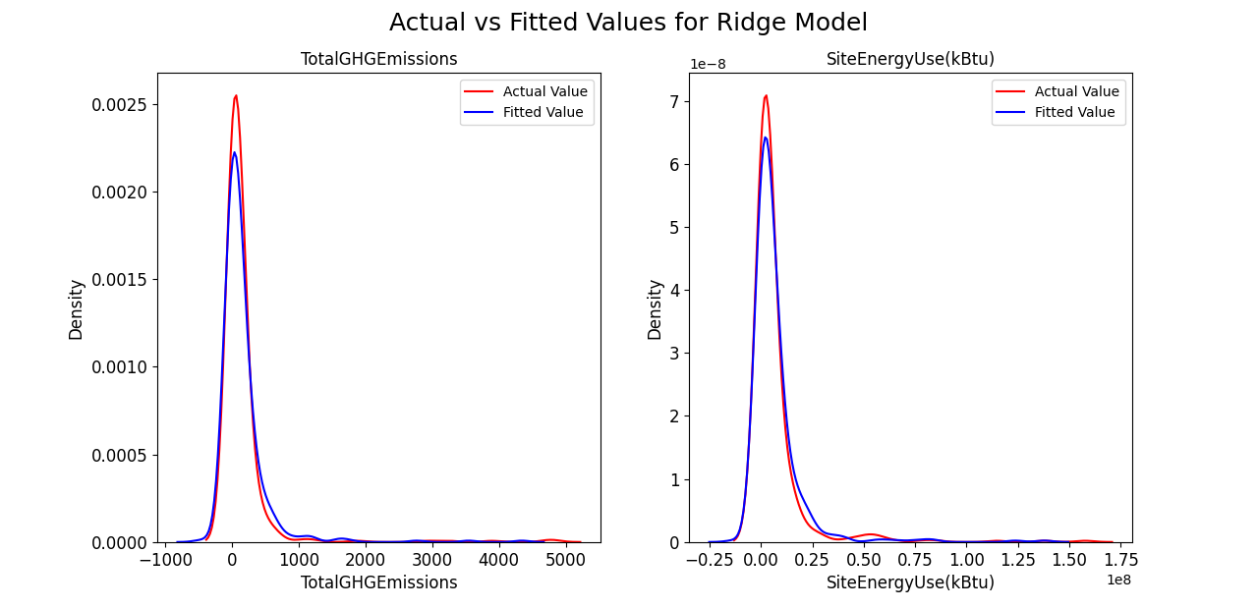
Modeling
Ridge Model

Slide 20
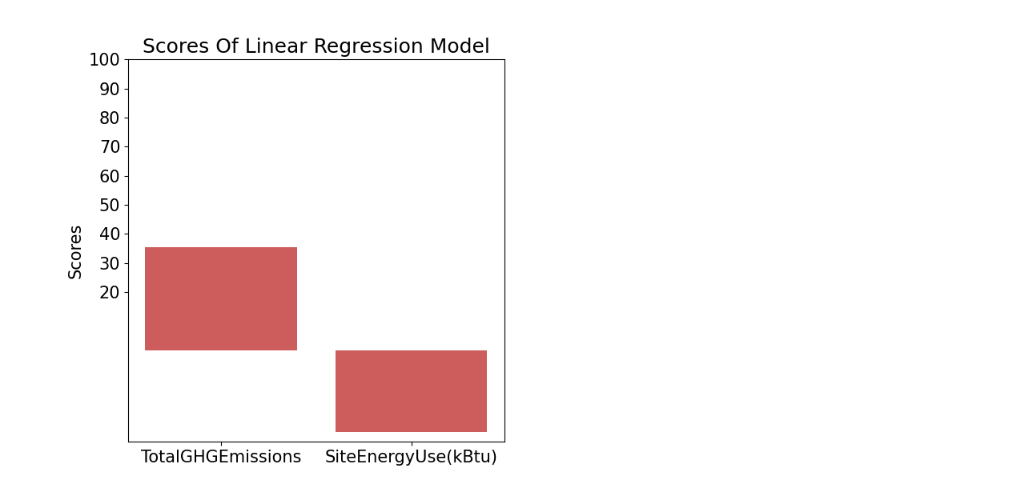
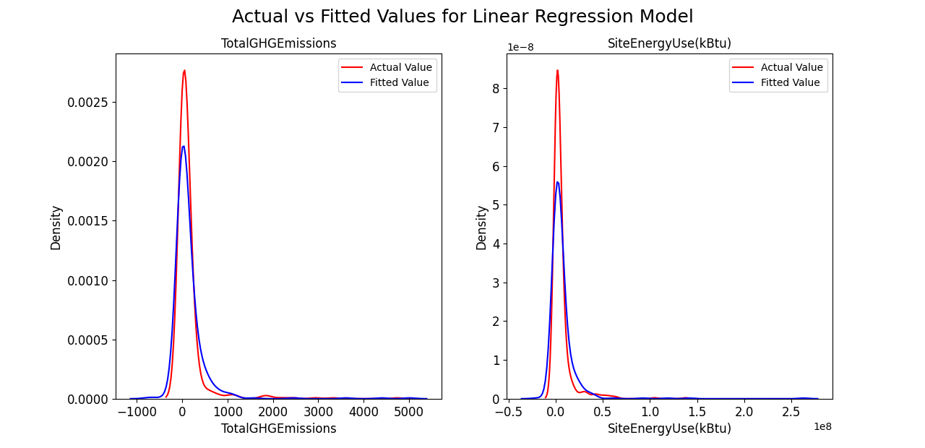
Modeling
Linear Regression Model

Slide 21
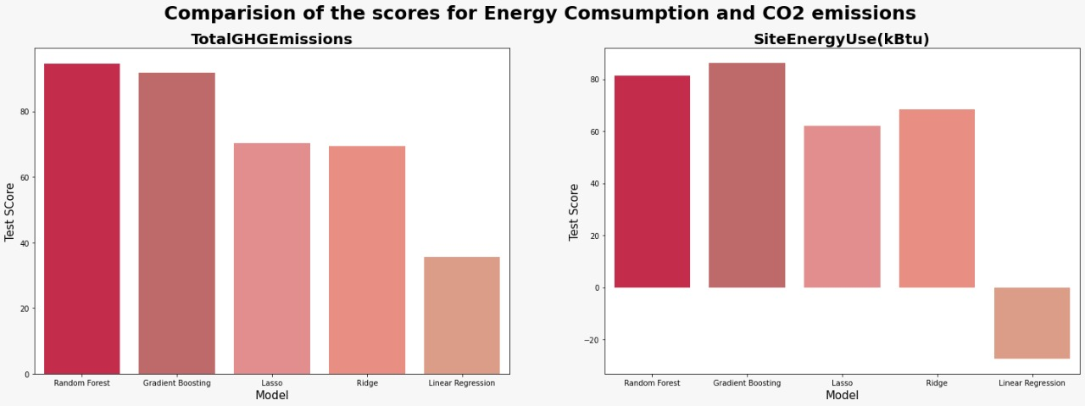
Conclusion
For predicting CO2 Emissions: The best model is the Random Forest Model
For Predicting Energy Consumption : The best model is Gradient Boosting Model.
Linear Regression is the worst model to be used

Slide 22
Slide 27
References
https://towardsdatascience.com/3-key-differences-between-merge-and-concat-functions-of-pandas-ab2bab224b59#:~:text=Concat%20function%20concatenates%20dataframes%20along,combinations%20based%20on%20a%20condition.
https://www.javatpoint.com/data-reduction-in-data-mining#:~:text=Data%20reduction%20is%20a%20process,integrity%20of%20the%20original%20data.
https://www.statisticshowto.com/lasso-regression/
https://machinelearningmastery.com/ridge-regression-with-python/
https://machinelearningmastery.com/linear-regression-for-machine-learning/

Slide 23

Thank You for your Attention
Questions?

